Slide 1


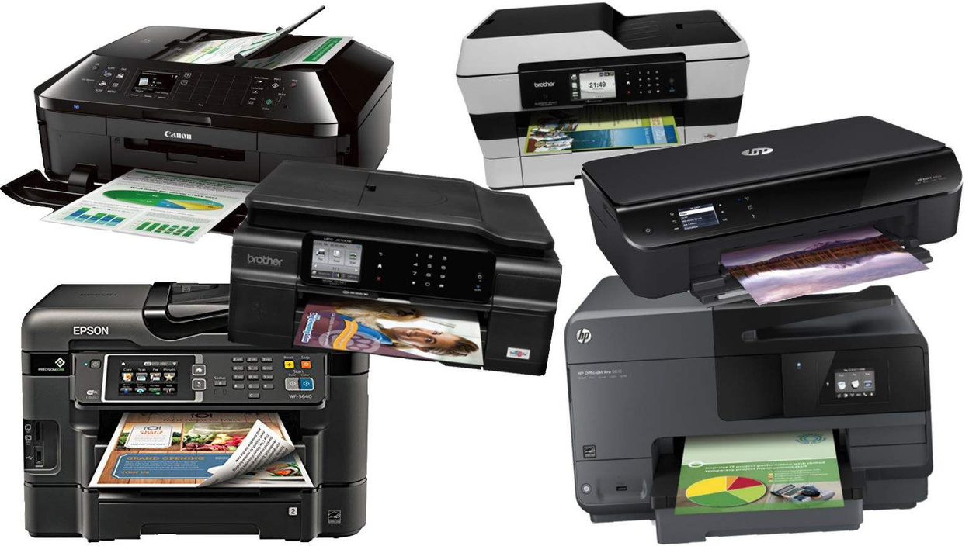
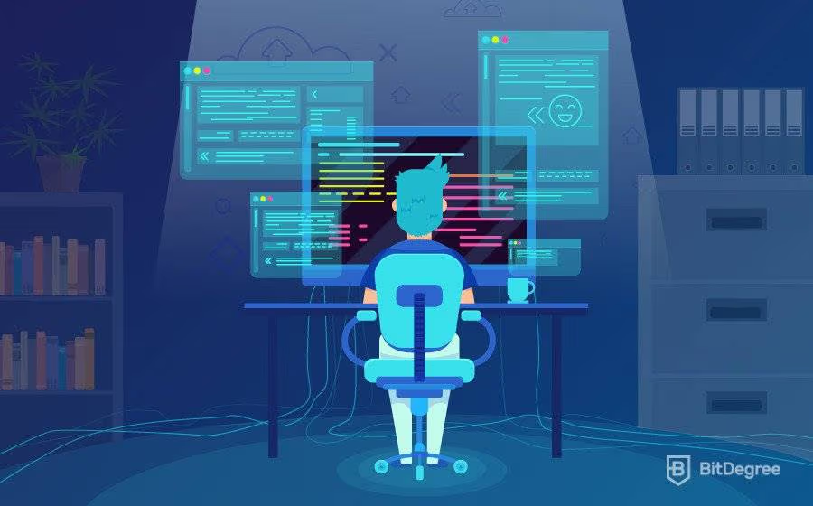
PRINTER JUNCTION
Empowering Your Ideas on Paper.
“A Journey in Web Development”

Slide 2


"Coding is today's literacy. It is the best way to express oneself in the digital age." - Aza Raskin

Slide 3







AGENDA
01
02
03
Introduction
Our Team
Our Objective
04
05
06
What we have used?
Our website & Demostration
Conclusion

Slide 4



Introducting Printer Junction
Hello everyone, today We are thrilled to present our collaborative effort, a culmination of creativity and technology—a web development project crafted for our college coursework

Slide 5

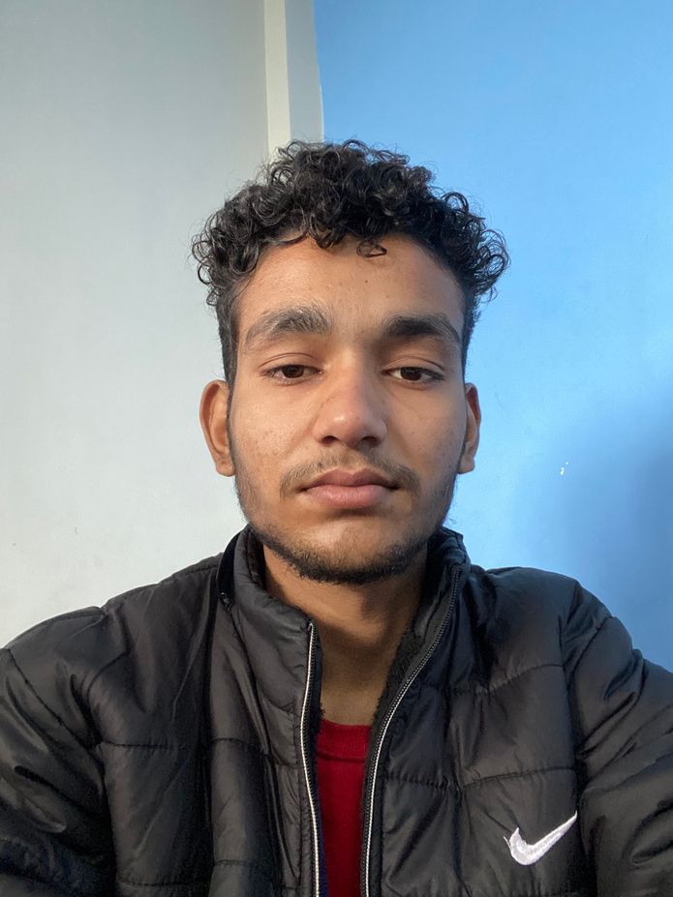
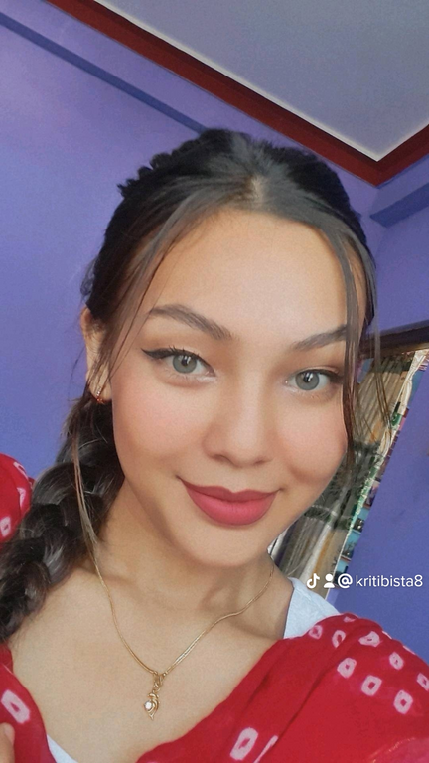
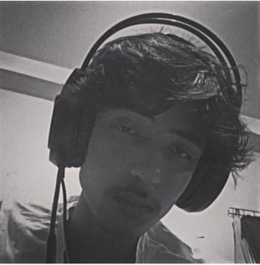
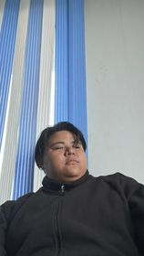
OUR TEAM
Meet the powerhouse behind our printer website – a collaborative team dedicated to transforming ideas into innovative digital solutions.
Bidur Siwakoti
Kriti Bista
Sakhyam Timsina
Prajwal Limbu

Slide 6
Objectives:
In this college web development project, our primary objectives are to:
To enhance proficiency in web development skills acquired during the coursework.
To apply theoretical knowledge of information systems to practical web development.
To gain hands-on experience in creating an intuitive and visually appealing user interface.
To showcase problem-solving capabilities
To maintain effective collaboration among team members throughout the project

Slide 7



what have we used??
HTML
CSS
JavaScript

Slide 8

Text editor used in this project
Visual Studio Code

Slide 9
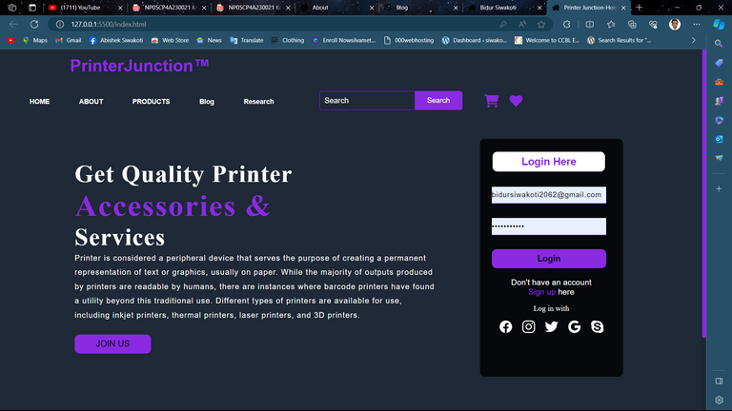
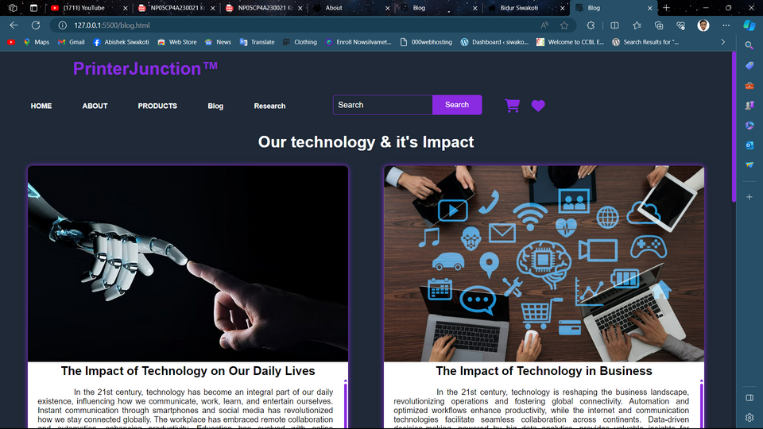

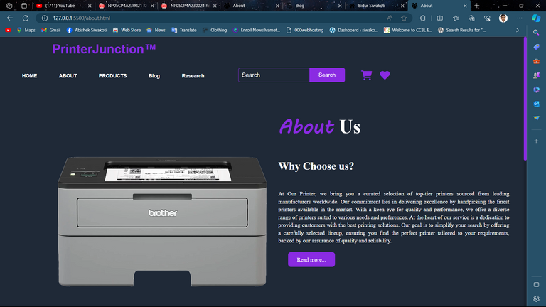
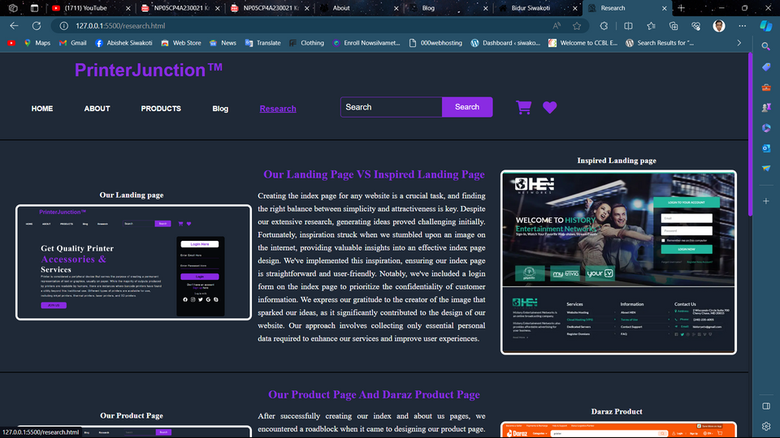
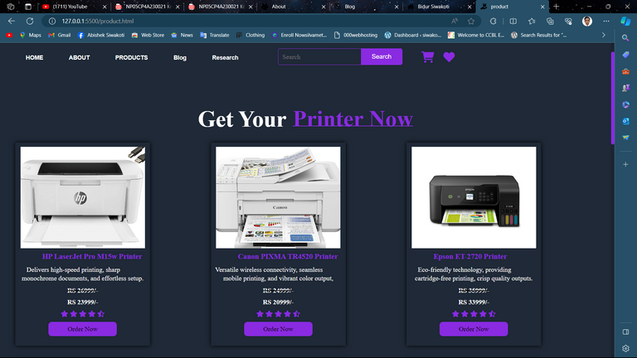
WEB PAGES

Slide 10
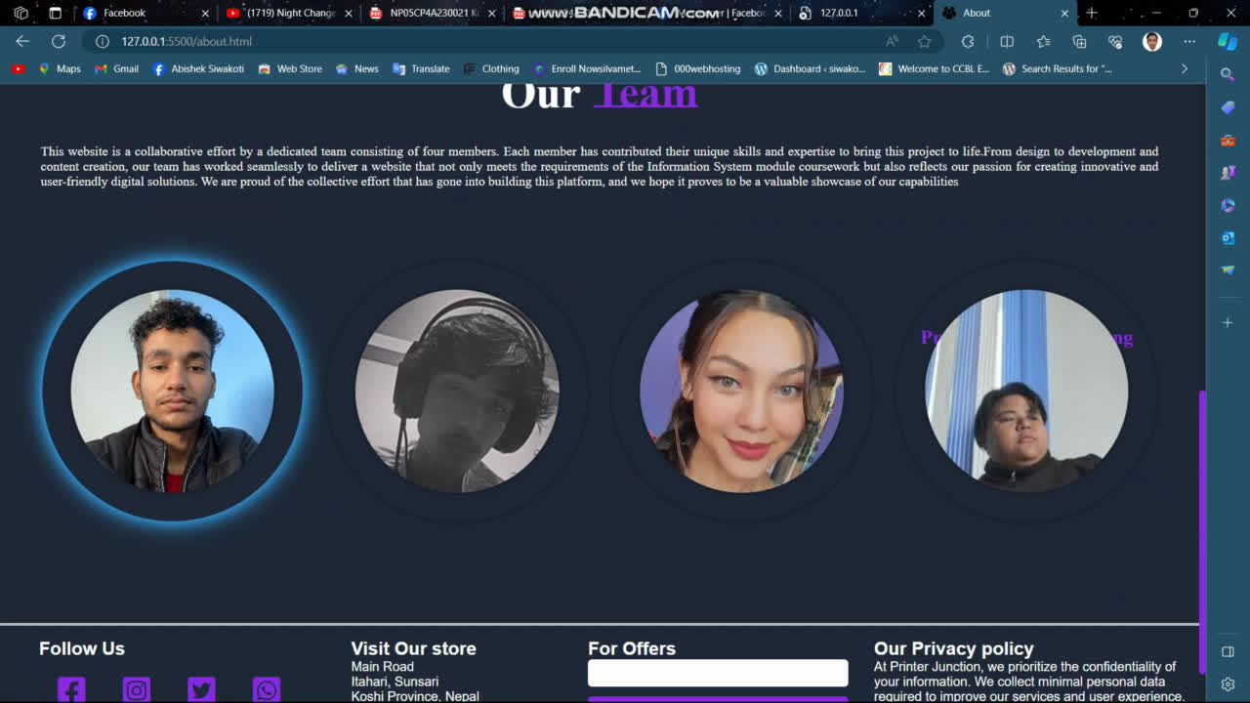

Slide 11
Web Pages
Index Page
About Page
Product Page
Blog page
Research Page

Slide 12



Conclusion
Overall, it was really a fun experience for us to work as a team. we got to learn different things from team work to technical work

Slide 13
Thank
you!

Slide 14


